Slide 1
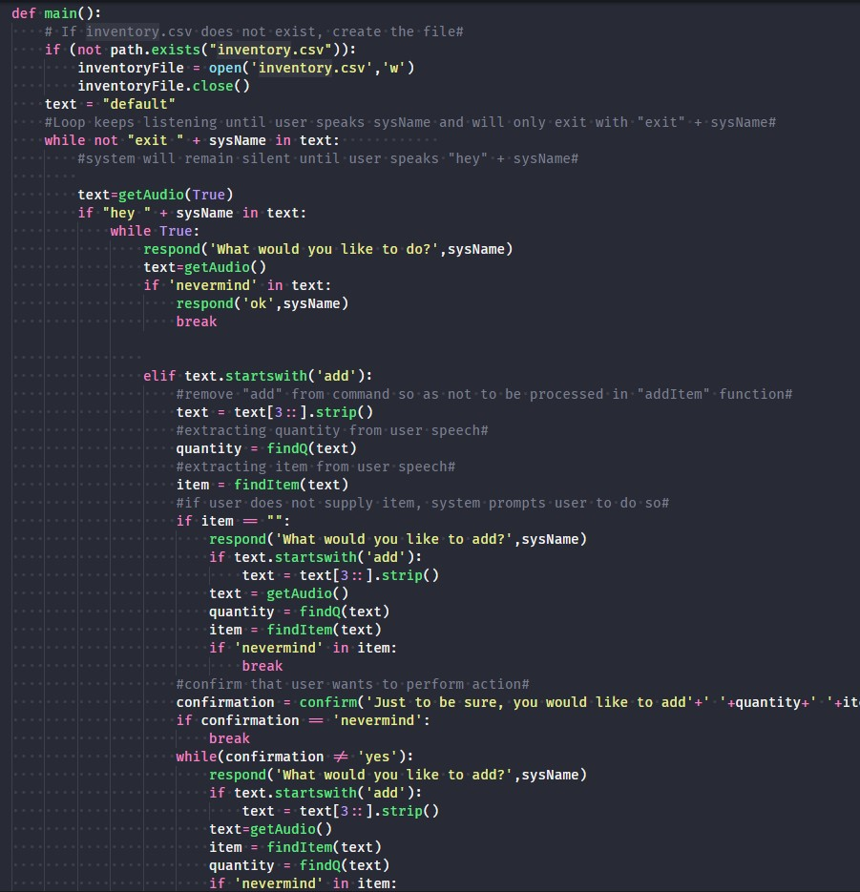


Voice-Activated Kitchen Assistant talk to your “kitchen”
“Hey, Kitchen.”
Michael Friedel
Baron Wasden
Github.com/ksu-is/Voice-Activated-Home-Food-Tracking-System

